Slide 1
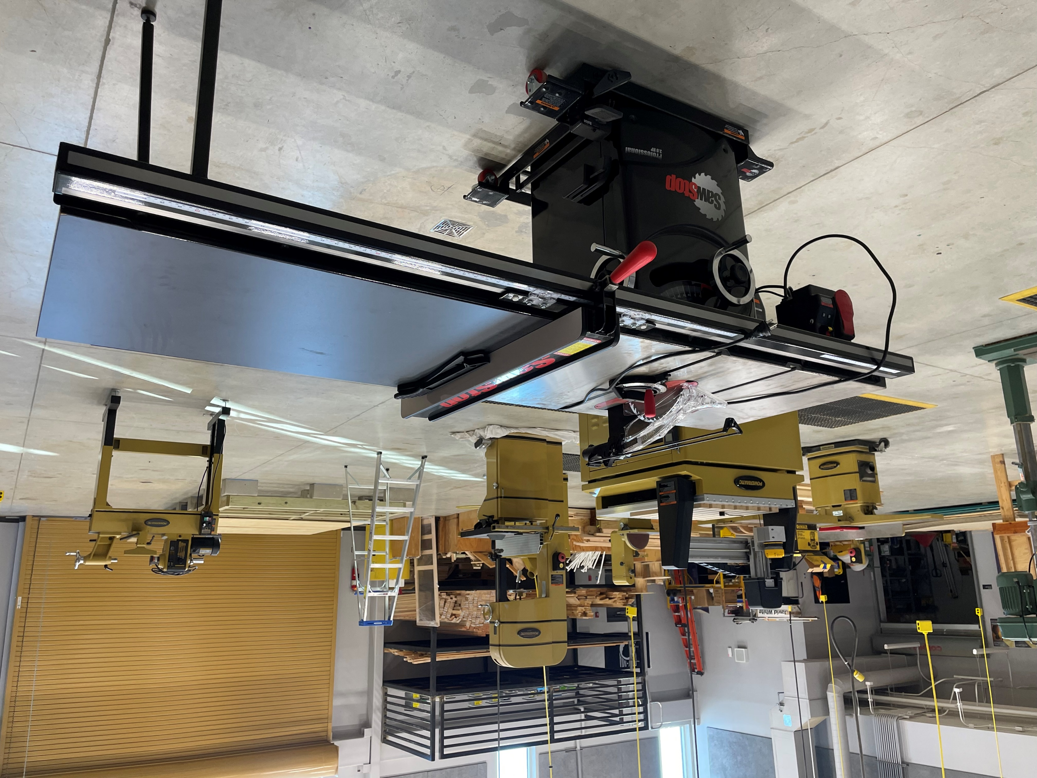
Construction Management and Inspection
Statewide Program of Study
Architecture and Construction Career Cluster
The Architecture and Construction Career Cluster focuses on designing, planning, managing, building, and maintaining the built environment. Principles of Architecture provides an overview to the various fields of architecture, interior design, and construction management.
Insert Image
The Construction Management and Inspection program of study explores the occupations and educational opportunities associated with cost estimates for construction projects or services to aid management in bidding on or determining the price of products or services. This program of study may also include exploration into inspecting structures using engineering skills to determine structural soundness and compliance with specifications, building codes, and other regulations.
Work-Based Learning and
Expanded Learning Opportunities
Secondary Courses for High School Credit
1 Principles of Construction
2 Construction Management I
3 Construction Management II
4 Practicum in Construction Mgmt.
Exploration Activities | Work-Based Learning Activities
Shadow a building inspector or cost estimator Participate in SkillsUSA | Intern with a construction company Shadow a project manager or inspector
Industry-Based Certifications
NCCER Construction Site Safety Technician
Postsecondary Opportunities
Associates Degrees
Construction Engineering Technology/Technician
Business Administration and Management, General
Mechanical Engineering
Business/ Commerce, General
Bachelor’s Degrees
Construction Engineering Technology/Technician
Business Administration and Management, General
Mechanical Engineering
Business/ Commerce, General
Master’s, Doctoral, and Professional Degrees
Materials Engineering
Business Administration and Management, General
Mechanical Engineering
Manufacturing Engineering
SMHS Construction Management Shop
Aligned Occupations
Occupations | Median Wage | Annual Openings | % Growth
Construction and Building Inspectors | $53,914 | 983 | 17%
Cost Estimators | $63,939 | 2,239 | 21%
Construction Managers | $87,402 | 2,401 | 14%
Successful completion of the Construction Management and Inspection program of study will fulfill requirements of the Business and Industry endorsement. Revised – August 2022

Slide 2
Construction Management and Inspection Course Information
COURSE NAME | SERVICE ID | PREREQUISITES | COREQUISITES
Principles of Construction | 13004220 (1 credit) 6205 | None | None
Construction Management I | 13004900 (2 credits) 6225 | Principles of Construction | None
Construction Management II | 13005000 (2 credits) TBD | Construction Management I | None
Practicum in Construction Management | 13006200 (2 credits) TBD | Construction Management II | None
FOR ADDITIONAL INFORMATION ON THE ARCHITECTURE & CONSTRUCTION CAREER CLUSTER,
PLEASE CONTACT: CJ Odam, SMCISD CTE Coordinator cj.odam@smcisd.net
San Marcos CISD does not discriminate on the basis of race, color, national origin, sex, disability or age in its programs or activities and provides equal access to the Boy Scouts and other designated youth groups. The following person has been designated to handle inquiries regarding the nondiscrimination policies: Stephanie Munoz ; 631 Mill St, San Marcos, TX 78666 ; 512-393-6700 ; stephanie.munoz@smcisd.net
Further nondiscrimination information can be found at smcisd.net/cte

